Slide 1
Computer Graphics: Line Drawing Algorithms
Scan Conversion Algorithms
(Midpoint Line)

Slide 2
Find out the first 7 pixels of the line segment starting from (0, 2) to (70, 52) using midpoint line algorithm

Slide 3
7
6
5
4
3
2
0
1
2
3
4
5
6
7

Slide 4
x | y | d | NE(+1,+1)/E(+1,0) | d updating | Pixel
0 | 2

Slide 5

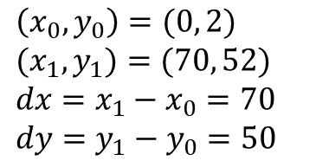
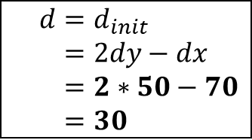

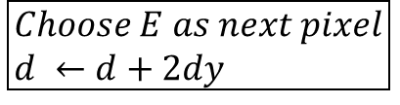
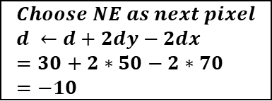
$$d=d_{init} \\ =2dy−dx \\ =2∗50−70 \\ =30$$
$$\left(x_{0},y_{0}\right)=(0, 2) \\ (x_{1},y_{1})=(70, 52) \\ dx=x_{1}−x_{0}=70 \\ dy=y_{1}−y_{0}=50$$
$$is d>0?$$
yes
no
$$Choose NE as next pixel \\ d ←d+2dy−2dx \\ =30+2∗50−2∗70 \\ =−10$$
$$Choose E as next pixel \\ d ←d+2dy$$
$$Check if current pixel is (x_{1},y_{1})$$
no
yes
end

Slide 6
x | y | d | NE(+1,+1)/E(+1,0) | d updating | Pixel
0 | 2 | 30 | NE | 30+2x50-2x70 = -10 | (0, 2)
1 | 3

Slide 7
7
6
5
4
3
2
0
1
2
3
4
5
6
7

Slide 8
x | y | d | NE(+1,+1)/E(+1,0) | d updating | Pixel
0 | 2 | 30 | NE | 30+2x50-2x70 = -10 | (0, 2)
1 | 3

Slide 9

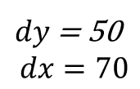
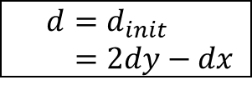
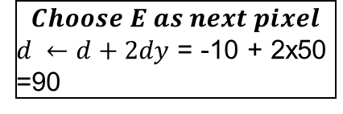
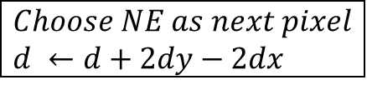
$$d=d_{init} \\ =2dy−dx$$
$dy$ = 50 $$dx=70$$
$$is d=−10>0?$$
yes
no
$$Choose NE as next pixel \\ d ←d+2dy−2dx$$
$$Choose E as next pixel$$ $d ←d+2dy$ = -10 + 2x50 =90
$$Check if current pixel is (x_{1},y_{1})$$
no
yes
end

Slide 10
x | y | d | NE(+1,+1)/E(+1,0) | d updating | Pixel
0 | 2 | 30 | NE | 30+2x50-2x70 = -10 | (0, 2)
1 | 3 | -10 | E | -10+2x50 = 90 | (1, 3)
2 | 3

Slide 11
7
6
5
4
3
2
0
1
2
3
4
5
6
7

Slide 12
x | y | d | NE(+1,+1)/E(+1,0) | d updating | Pixel
0 | 2 | 30 | NE | 30+2x50-2x70 = -10 | (0, 2)
1 | 3 | -10 | E | -10+2x50 = 90 | (1, 3)
2 | 3

Slide 13

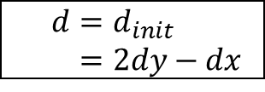
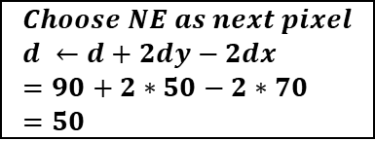
$$d=d_{init} \\ =2dy−dx$$
$dy$ = 50 $$dx=70$$
$$is d=90>0?$$
yes
no
$$Choose NE as next pixel \\ d ←d+2dy−2dx \\ =90+2∗50−2∗70 \\ =50$$
$$Choose E as next pixel \\ d ←d+2dy$$
$$Check if current pixel is (x_{1},y_{1})$$
no
yes
end

Slide 14
x | y | d | NE(+1,+1)/E(+1,0) | d updating | Pixel
0 | 2 | 30 | NE | 30+2x50-2x70 = -10 | (0, 2)
1 | 3 | -10 | E | -10+2x50 = 90 | (1, 3)
2 | 3 | 90 | NE | 90+2x50-2x70 = 50 | (2, 3)
3 | 4

Slide 15
7
6
5
4
3
2
0
1
2
3
4
5
6
7

Slide 16
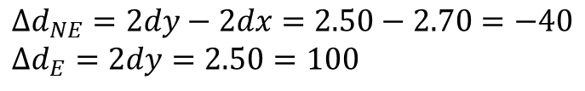
$$Δd_{NE}=2dy−2dx=2.50−2.70=−40 \\ Δd_{E}=2dy=2.50=100$$
x | y | d | NE(+1,+1)/E(+1,0) | d updating | Pixel
0 | 2 | 30 | NE | 30+2x50-2x70 = -10 | (0, 2)
1 | 3 | -10 | E | -10+2x50 = 90 | (1, 3)
2 | 3 | 90 | NE | 90+2x50-2x70 = 50 | (2, 3)
3 | 4

Slide 17
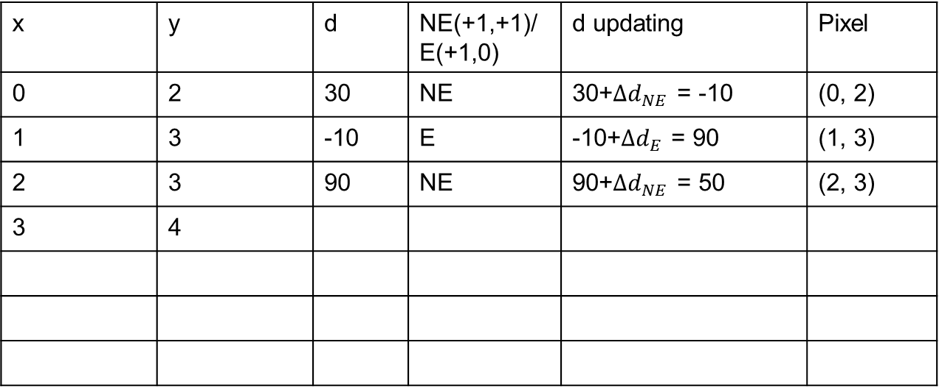
$$Δd_{NE}=2dy−2dx=2.50−2.70=−40 \\ Δd_{E}=2dy=2.50=100$$
x | y | d | NE(+1,+1)/E(+1,0) | d updating | Pixel
0 | 2 | 30 | NE | 30+$Δd_{NE}$ = -10 | (0, 2)
1 | 3 | -10 | E | -10+$Δd_{E}$ = 90 | (1, 3)
2 | 3 | 90 | NE | 90+$Δd_{NE}$ = 50 | (2, 3)
3 | 4

Slide 18
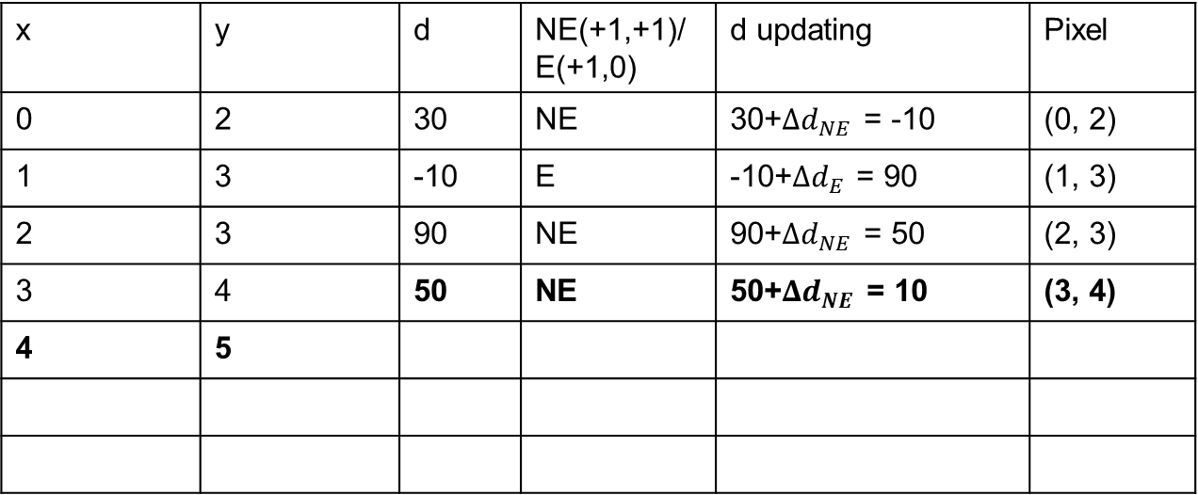
$$Δd_{NE}=2dy−2dx=2.50−2.70=−40 \\ Δd_{E}=2dy=2.50=100$$
x | y | d | NE(+1,+1)/E(+1,0) | d updating | Pixel
0 | 2 | 30 | NE | 30+$Δd_{NE}$ = -10 | (0, 2)
1 | 3 | -10 | E | -10+$Δd_{E}$ = 90 | (1, 3)
2 | 3 | 90 | NE | 90+$Δd_{NE}$ = 50 | (2, 3)
3 | 4 | 50 | NE | 50+$Δd_{NE}$ = 10 | (3, 4)
4 | 5

Slide 19
7
6
5
4
3
2
0
1
2
3
4
5
6
7

Slide 20
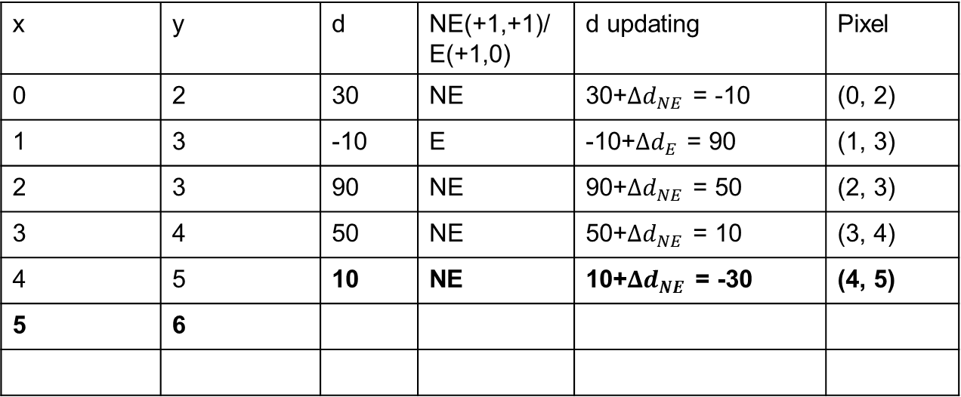
$$Δd_{NE}=2dy−2dx=2.50−2.70=−40 \\ Δd_{E}=2dy=2.50=100$$
x | y | d | NE(+1,+1)/E(+1,0) | d updating | Pixel
0 | 2 | 30 | NE | 30+$Δd_{NE}$ = -10 | (0, 2)
1 | 3 | -10 | E | -10+$Δd_{E}$ = 90 | (1, 3)
2 | 3 | 90 | NE | 90+$Δd_{NE}$ = 50 | (2, 3)
3 | 4 | 50 | NE | 50+$Δd_{NE}$ = 10 | (3, 4)
4 | 5 | 10 | NE | 10+$Δd_{NE}$ = -30 | (4, 5)
5 | 6

Slide 21
7
6
5
4
3
2
0
1
2
3
4
5
6
7

Slide 22
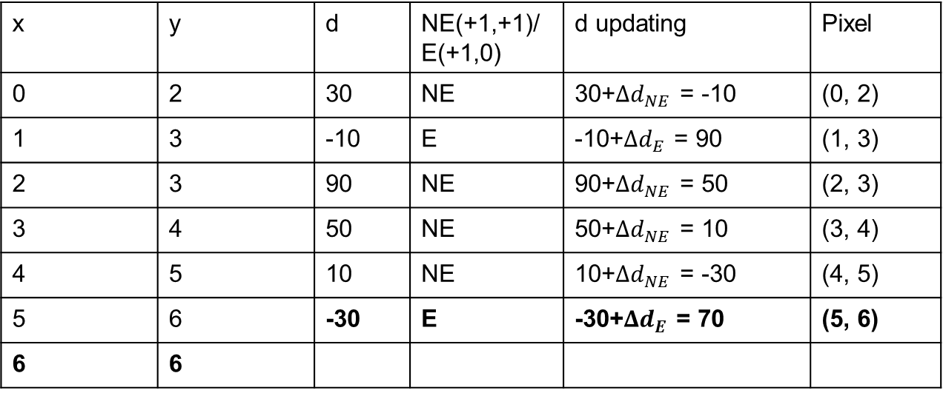
$$Δd_{NE}=2dy−2dx=2.50−2.70=−40 \\ Δd_{E}=2dy=2.50=100$$
x | y | d | NE(+1,+1)/E(+1,0) | d updating | Pixel
0 | 2 | 30 | NE | 30+$Δd_{NE}$ = -10 | (0, 2)
1 | 3 | -10 | E | -10+$Δd_{E}$ = 90 | (1, 3)
2 | 3 | 90 | NE | 90+$Δd_{NE}$ = 50 | (2, 3)
3 | 4 | 50 | NE | 50+$Δd_{NE}$ = 10 | (3, 4)
4 | 5 | 10 | NE | 10+$Δd_{NE}$ = -30 | (4, 5)
5 | 6 | -30 | E | -30+$Δd_{E}$ = 70 | (5, 6)
6 | 6

Slide 23
7
6
5
4
3
2
0
1
2
3
4
5
6
7

Slide 24
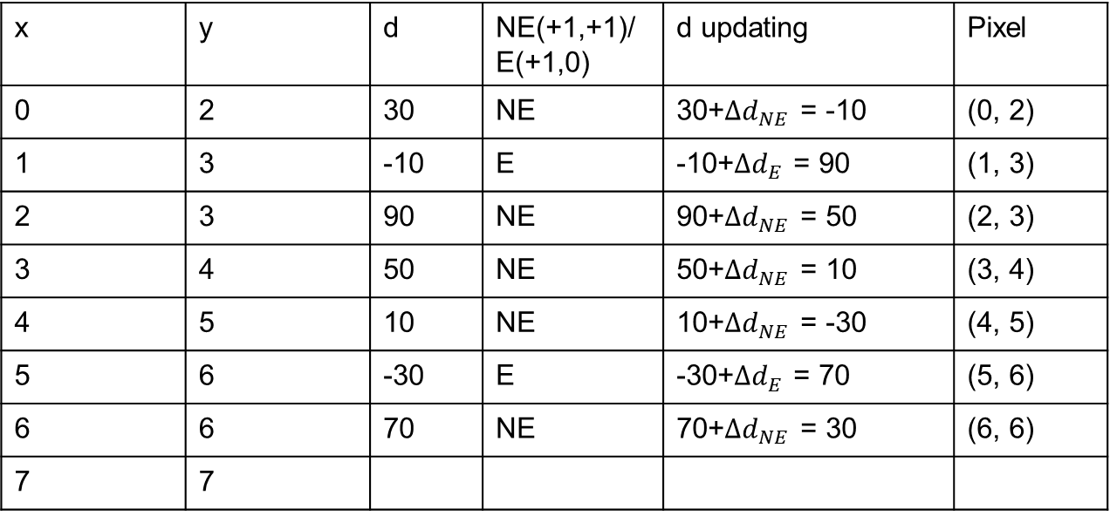
$$Δd_{NE}=2dy−2dx=2.50−2.70=−40 \\ Δd_{E}=2dy=2.50=100$$
x | y | d | NE(+1,+1)/E(+1,0) | d updating | Pixel
0 | 2 | 30 | NE | 30+$Δd_{NE}$ = -10 | (0, 2)
1 | 3 | -10 | E | -10+$Δd_{E}$ = 90 | (1, 3)
2 | 3 | 90 | NE | 90+$Δd_{NE}$ = 50 | (2, 3)
3 | 4 | 50 | NE | 50+$Δd_{NE}$ = 10 | (3, 4)
4 | 5 | 10 | NE | 10+$Δd_{NE}$ = -30 | (4, 5)
5 | 6 | -30 | E | -30+$Δd_{E}$ = 70 | (5, 6)
6 | 6 | 70 | NE | 70+$Δd_{NE}$ = 30 | (6, 6)
7 | 7

Slide 25
7
6
5
4
3
2
0
1
2
3
4
5
6
7

Slide 26
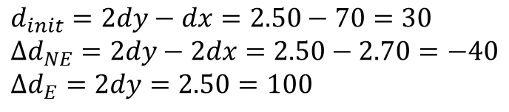
$$d_{init}=2dy−dx=2.50−70=30 \\ Δd_{NE}=2dy−2dx=2.50−2.70=−40 \\ Δd_{E}=2dy=2.50=100$$
x | y | d | NE(+1,+1)/E(+1,0) | d updating | Pixel
0 | 2 | 30 | NE | 30+$Δd_{NE}$ = -10 | (0, 2)
1 | 3 | -10 | E | -10+$Δd_{E}$ = 90 | (1, 3)
2 | 3 | 90 | NE | 90+$Δd_{NE}$ = 50 | (2, 3)
3 | 4 | 50 | NE | 50+$Δd_{NE}$ = 10 | (3, 4)
4 | 5 | 10 | NE | 10+$Δd_{NE}$ = -30 | (4, 5)
5 | 6 | -30 | E | -30+$Δd_{E}$ = 70 | (5, 6)
6 | 6 | 70 | NE | 70+$Δd_{NE}$ = 30 | (6, 6)
7 | 7

